Slide 1
Group 06 Food Waste

Slide 2
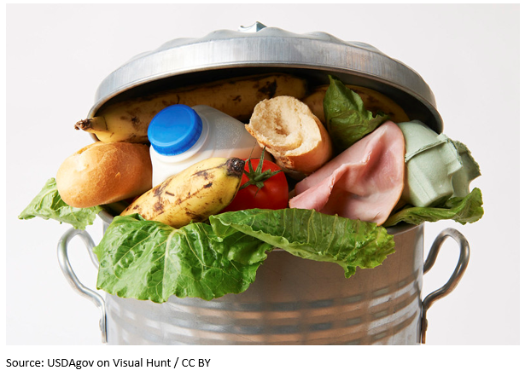
Do you know?......
In Ireland
~1 million* tonnes per annum
303,000 tonnes Commercial Food Waste
Food Retail 23 kg/m2/year
Fruit and veg most wasted food in retail
Source: https://ec.europa.eu/food/system/files/2020-11/fw_eu-platform_20201125_fwm-webinar_pres-2.pdf
Notes:
According to Food waste data studies in Ireland,

Slide 3
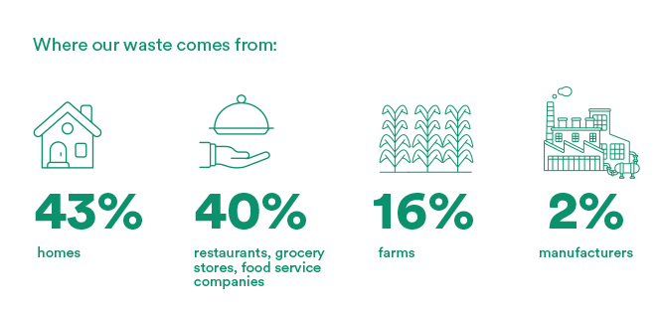
Do you know?......
Food Waste in America in 2022
Source: https://www.rts.com/resources/guides/food-waste-america/

Slide 4
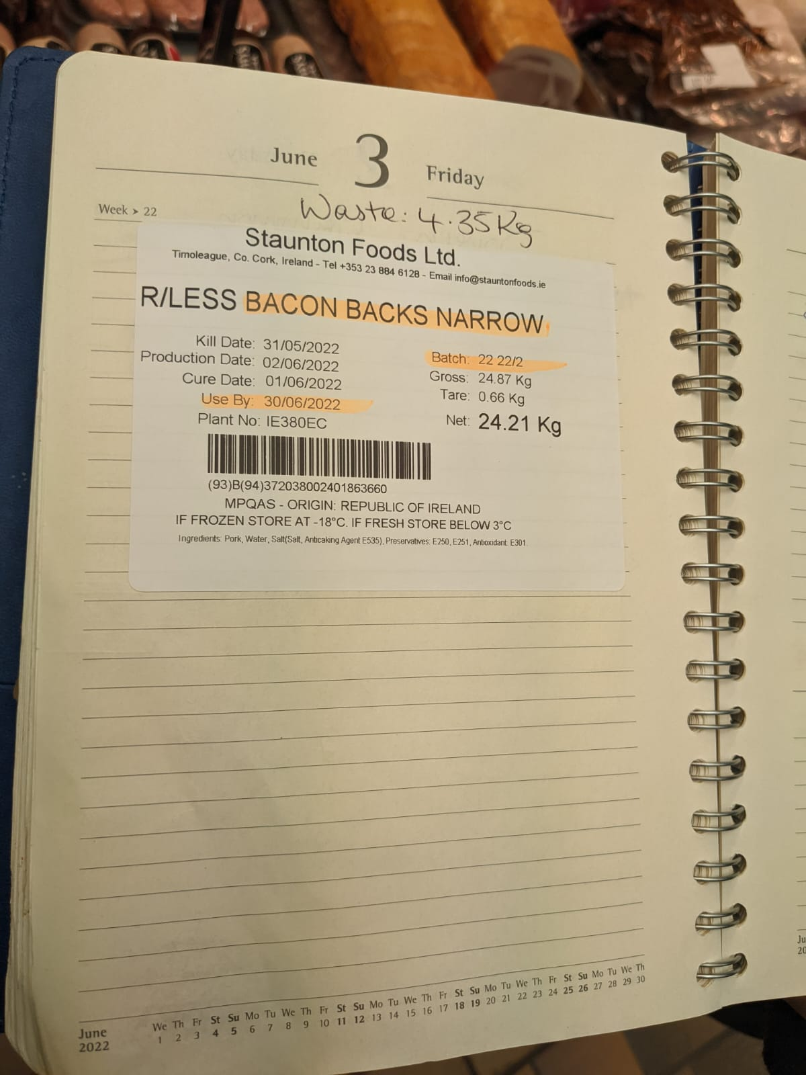
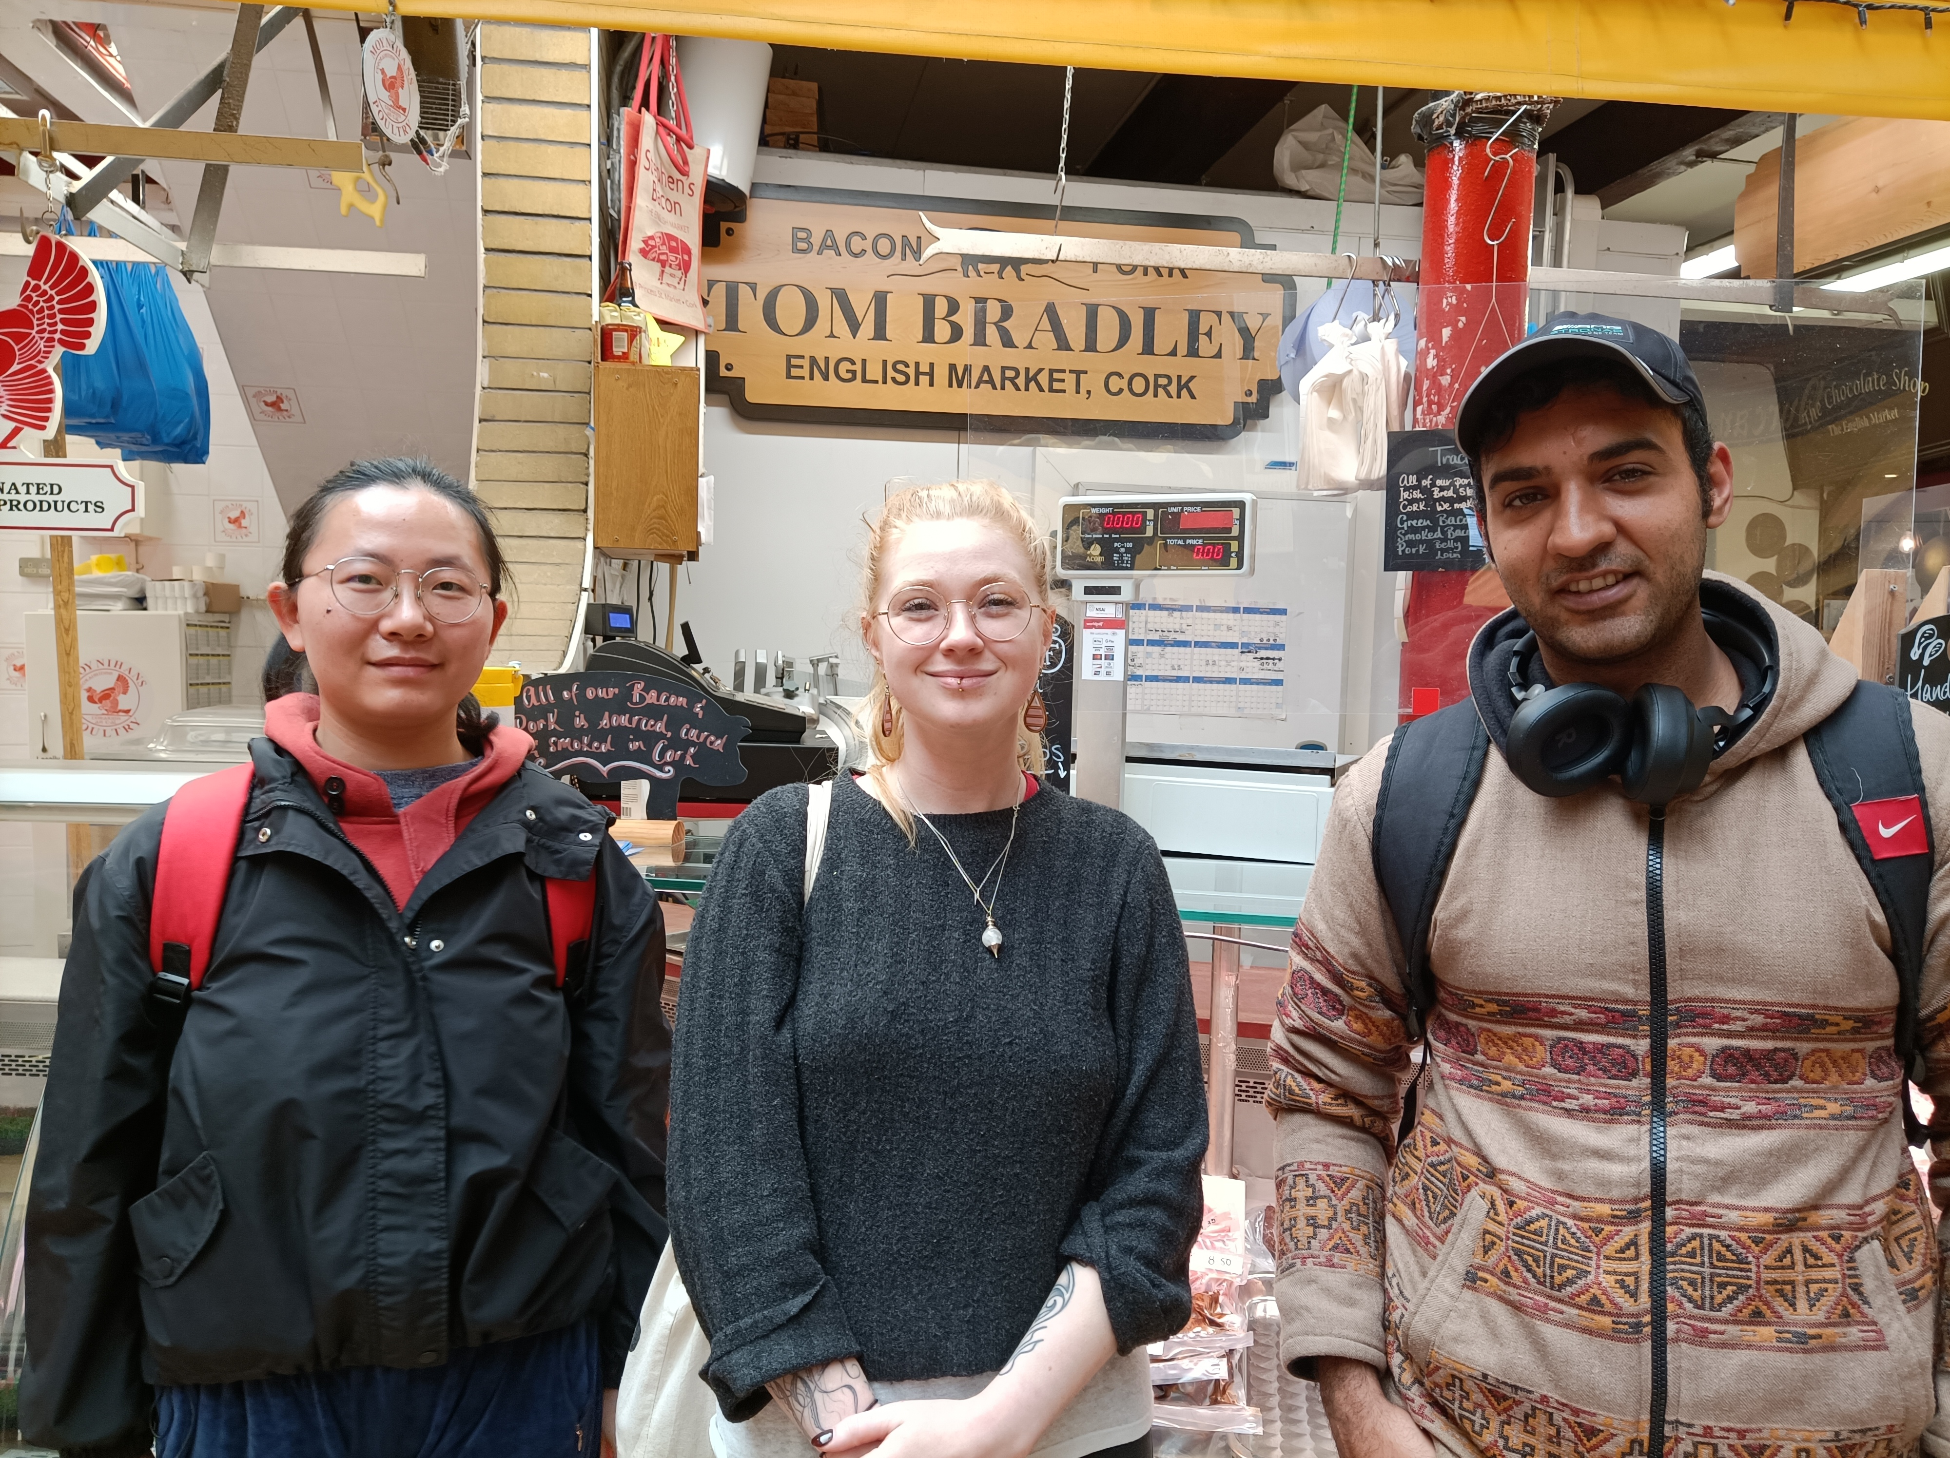
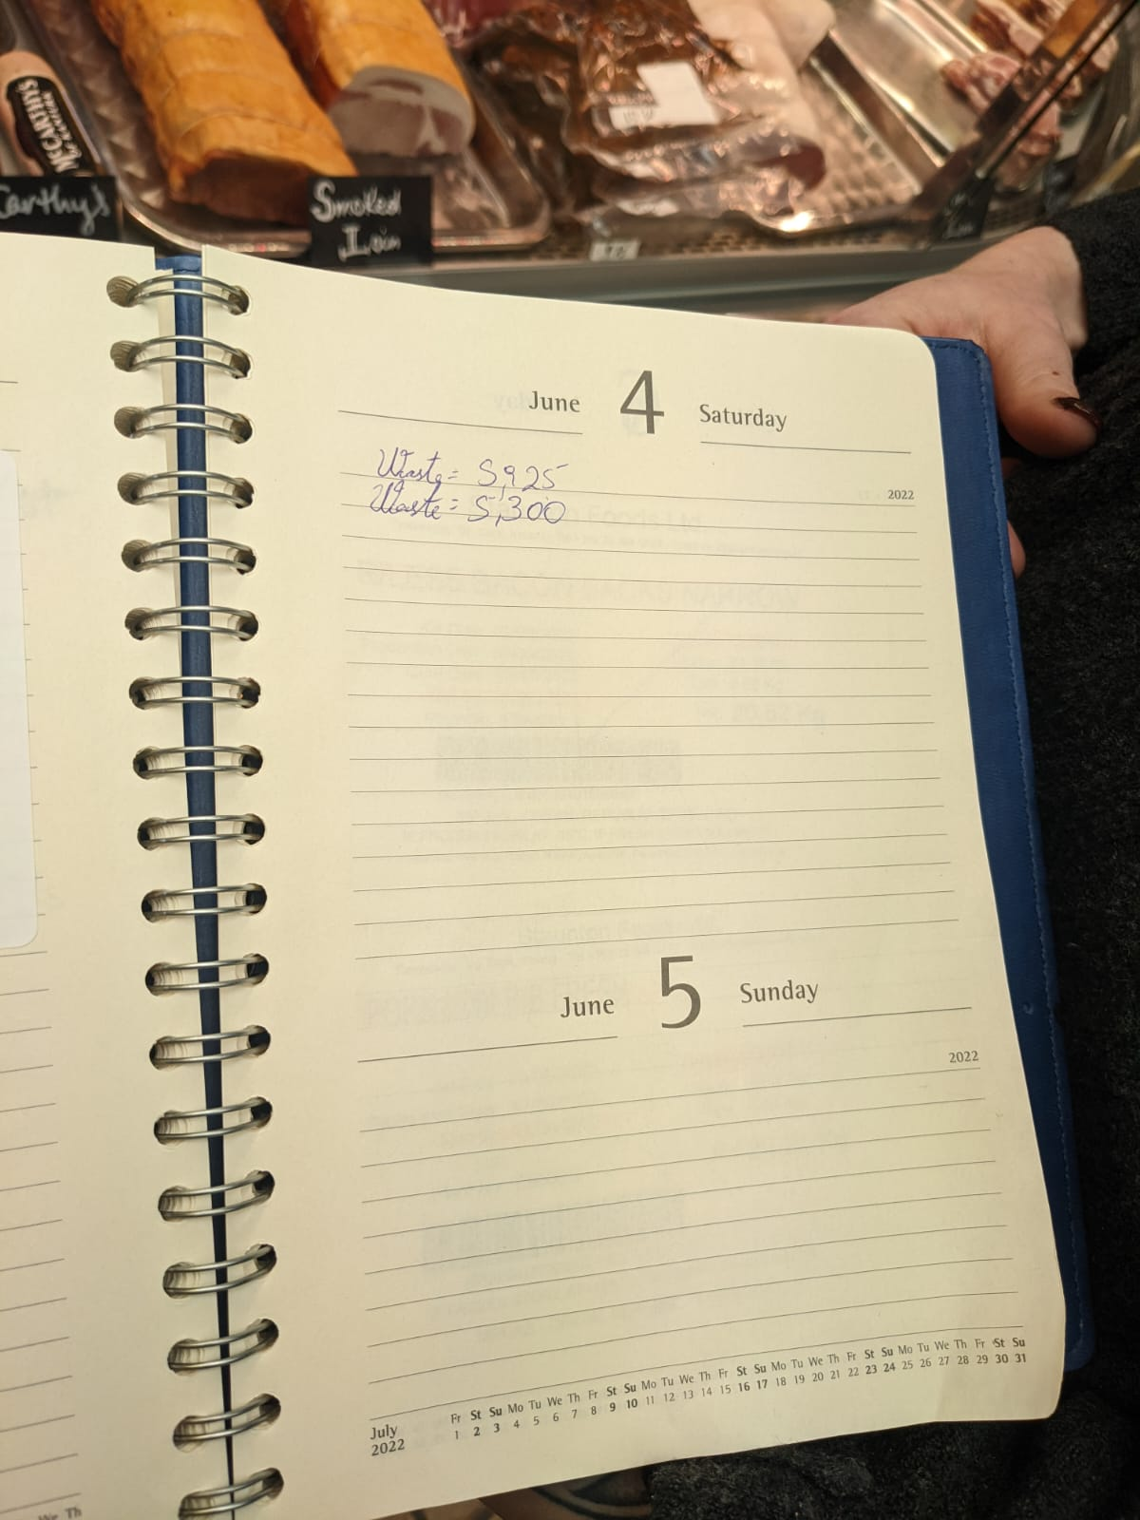
Kayla, chef, store manager, food lover
4.35 KG/week,
worth 94 euros
Notes:
Let’s check out one real world example, Kayla She grows her love toward food from chef to a bacon store manager, where makes use of raw food material

Slide 5

Good news is that help is ready for you……
Reducing food waste for your store by optimizing your profit through modeling your inventory operations

Slide 6
Our model helps you to make a future business plan
Estimated demand
Inventory level
What
Ordering cost
Unit cost
Store
Order
When
Inventory cost
Normal price
Ordering case size
How
Elasticity
Notes:
Help you understand how much to order would meet your

Slide 7
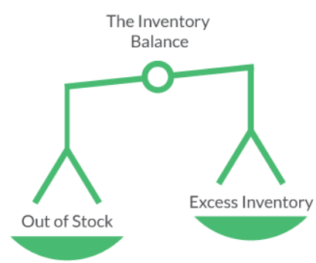
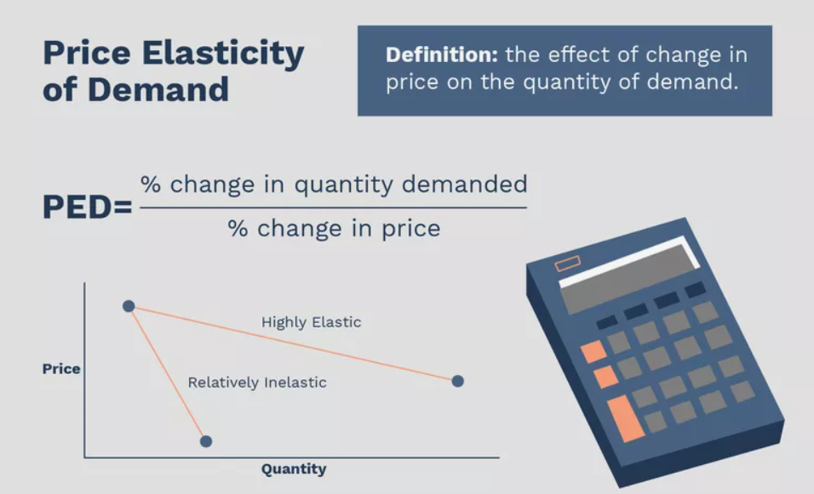
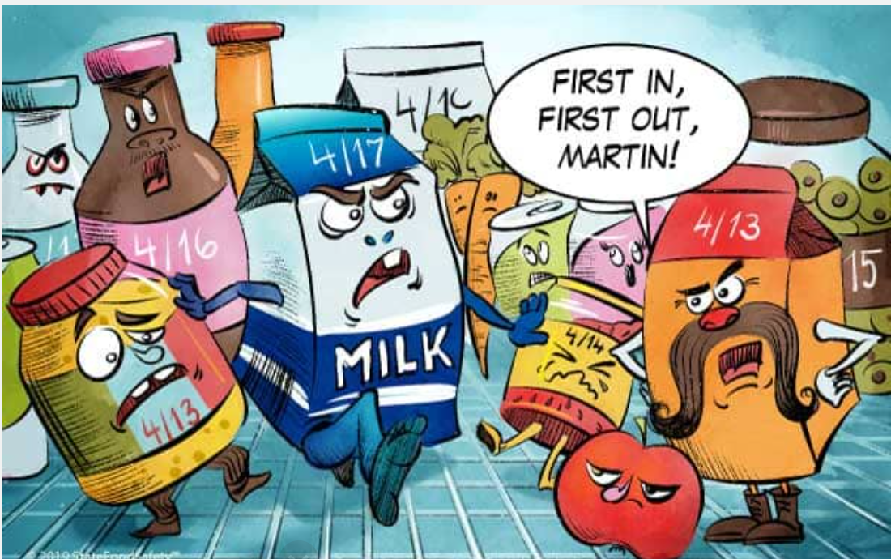
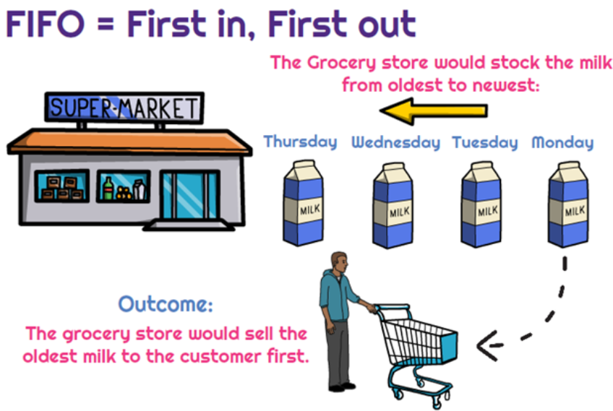
Business Practice encoded in the Optimization Model
Inventory Balance
First In First Out
Induced Demand Through Adjusted Price
Notes:
P65,

Slide 8
Why Optimization Technology?
How to achieve target?
Value
What will
happen?
Information Optimization
What
happened?
Difficulty
Notes:
transforming a business problem into an optimization model and then into an effective business application

Slide 9


Simple Efficient Tech Stack
Python
+
CPLEX
+
Ploty Dash
+
Constraint Programming
Notes:
CP: The second major technology for optimization is Constraint Programming (CP), which is a branch of Computer Science (also known as Logic Programming). CP
has roots in the Artificial Intelligence (AI) and Expert System efforts of the 1980s. It is also a development of the move to object-oriented approaches to software
development in the 1990s. Its approach to optimization is completely different from the approach of MP. CP finds feasible solutions by rapidly eliminating
possibilities, zeroing in on feasible combinations of resource assignments and activities. CP is used when there are too many possible combinations or too
many individual constraints that affect sequence and timing for MP to find a solution in an acceptable time frame. This is called coping with the combinatorial
explosion of possibilities. CP approaches optimality by using a continuous improvement process that is based on the systematic comparison of new
solutions to a base feasible solution. As a result, CP can find good solutions to large, intricate scheduling and routing problems quickly. It can find solutions in minutes that would take MP hours or even days, assuming that an MP model could even find a solution.

Slide 10
Individual small store
Compete with Musgrave
Phase 1: 6m
Phase 2: 12m
Phase 3: 24m
Phase 4: 36m
June 22
Sales
July 22
Dec 22
Jan 23
July 23
July 23
June 23
July 23
July 24
V3.6 Instant Inventory Optimizer Launch
V4.6 Inventory Mngt.
Platform Launch
V 5.6 Predictive
Inventory Mngt.
Platform Launch
Maintaince &
Further Improvement
Demand
Non Linear Constraint Programming Optimization Model
Database Capability
Predictive Analytics
Notes:
This is the link between technology and market! At last, let’s have a quick look at roadmap in three years, we have worked out the initial business segment according to our technology plan in next 3 years into 4 phase

Slide 11
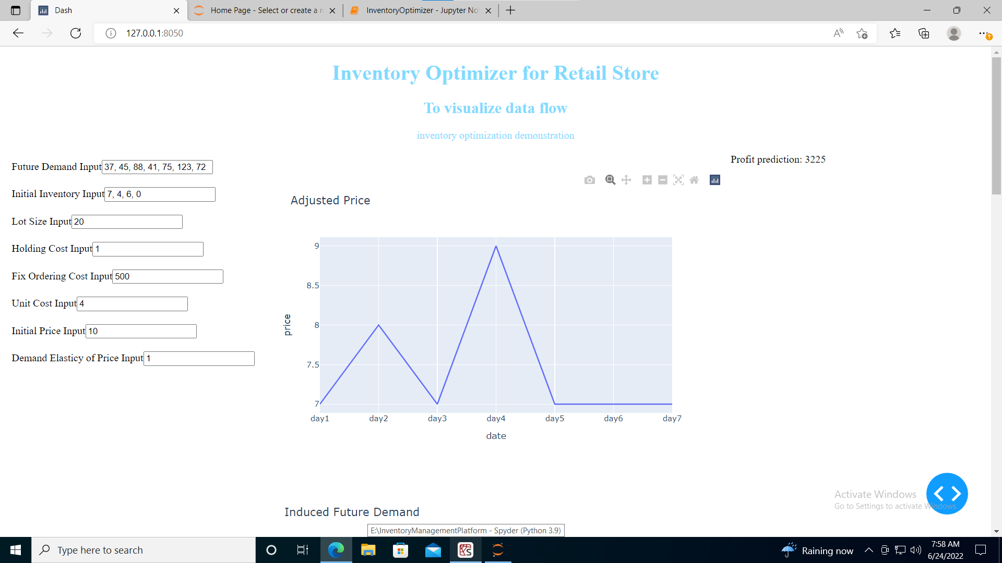
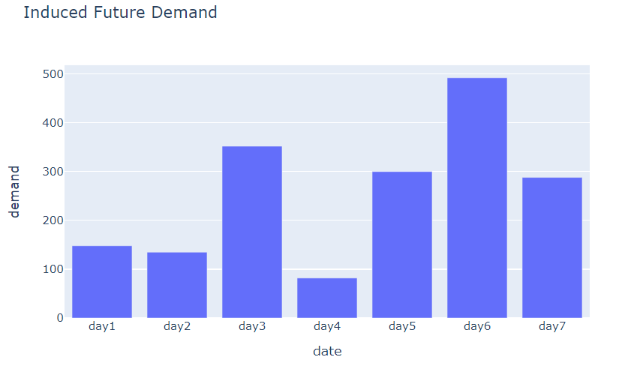
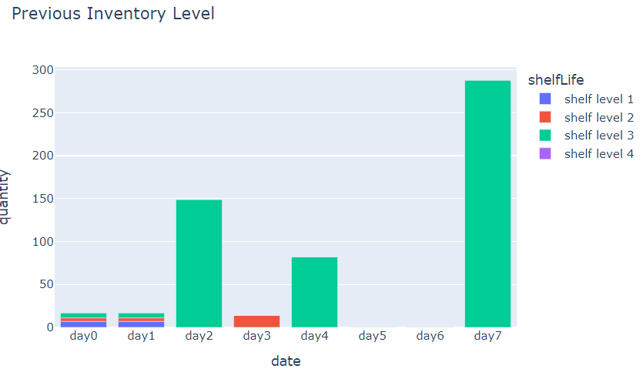
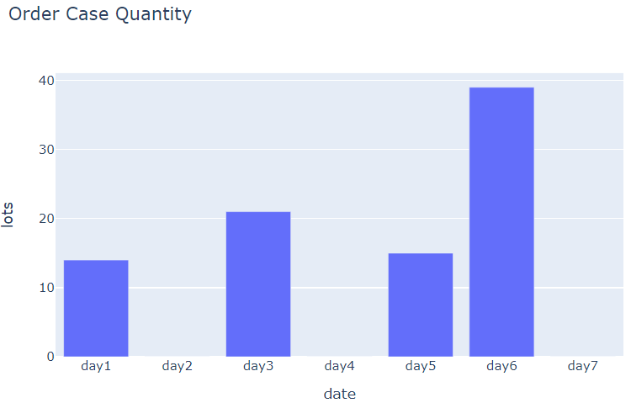
Notes:
Explain the shelf level 1

